Slide 1
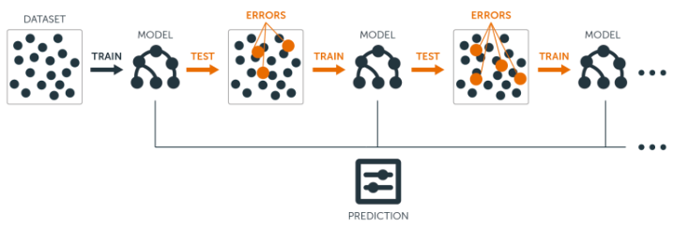
Boosted Trees
Sam Kloese, ACAS, CSPA
P/C Rate Modeling Actuary
Image from Introduction to Boosted Trees – The Official Blog of BigML.com

Slide 2
Introduction
GLM’s are industry standard
The CASTF White Paper for Predictive Models is focused primarily on GLM’s
New Appendix for Random Forests has been adopted
Boosted trees are very similar with a couple differences

Slide 3
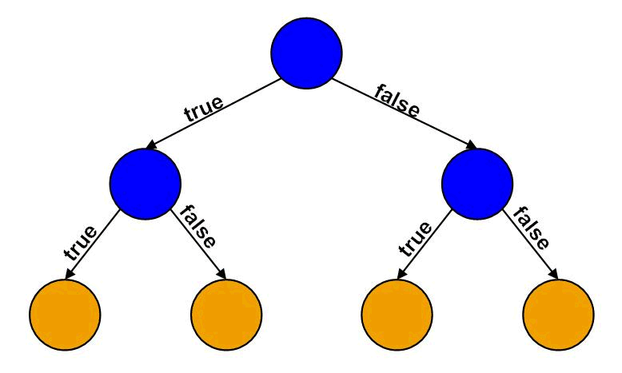
Tree Based Model Review
Prior Claim?
Single Decision Tree
Easy to Understand
Mimics how people make decisions
Easily interpreted
Age < 20?
Age < 20?

Slide 4
Tree Based Model Review
Prior Claim?
Single Decision Tree
Easy to Understand
Mimics how people make decisions
Easily interpreted
Classification returns a likelihood
Age < 20?
Age < 20?
10%
8%
7%
3%

Slide 5
Tree Based Model
Prior Claim?
Single Decision Tree
Easy to Understand
Mimics how people make decisions
Easily interpreted
Classification returns a likelihood
Age < 20?
Age < 20?

Slide 6
Tree Based Model Review
Prior Claim?
Single Decision Tree
Easy to Understand
Mimics how people make decisions
Easily interpreted
Classification returns a likelihood
Regression returns a predicted amount
Age < 20?
Age < 20?
$20
$16
$14
$6

Slide 7
Tree Based Model Review
Prior Claim?
Terminology
Nodes
Root
Sub-Node
Parent/Child
Splitting
Branch
Sub-Tree
Age < 20?
Age < 20?
$20
$16
$14
$6

Slide 8
Random Forest Review
Prior Claim?
Age < 20?
Veh Age < 10?
Random Forest
Each tree is based on a different bootstrap sample
Additionally: Randomly chosen variables considered at each split
Each tree is grown the same way
Final prediction is the average of each trees prediction
Advantages
Trees are substantially different
Each tree not based on the same sample
Each split not based on the same variables
$20
$16
$10
$8
Age < 35?
Vehicle < 20K?
Prior Claim?
$15
$20
$18
$14

Slide 9
Random Forest Review
Hyperparameters
Number of trees
Criteria on which to split
Bootstrap sample size (% of rows)
When to stop splitting
Max Tree Depth
Minimum Node Size
Max Leaf Nodes
Random Variables for each split (# of columns)

Slide 10
Differences Between RF and Boosted Trees
Main differences
Boosting is run sequentially
Each subsequent tree attempts to refine the model further
The data is reweighted after each tree, so subsequent trees focus more on wrong predictions
Often takes longer to run than RF, trees can not be run simultaneously
New Hyperparameter “Learning Rate”
Also known as “shrinkage parameter”
Between 0 and 1 (usually small, closer to 0)
There is a trade off between number of trees and learning rate

Slide 11
Boosted Trees
Boosted Trees algorithms:
Adaboost (Adative Boosting)
GBM (Gradient Boosting Machines)
XGBoost (eXtreme Gradient Boosting)
CatBoost (Categorical Boosting)

Slide 12
XGBoost
Particularly Popular Boosting Algorithm
Many machine learning competitions won with XGBoost
Available in open source software R and Python
Xgboost() function arguments
Common Hyperparameters
Max_depth: how many splits deep can a tree grow
Nrounds: Number of trees
Eta: Learning Rate
Colsample_bytree: % of columns (predictor variables) to use at each split
Subsample: % of rows (records) to use within each tree

Slide 13
XGBoost
Other xgboost() function arguments
Specifying the input data
Data = matrix containing predictor variables
Label = matrix containing target variable
Weight = matrix containing weights (earned exposures, claim counts, etc.)
Specifying the learning objection (many options)
Objective = Reg:squarederror
Objective = Reg:logistic
Objective = Count:poisson
Objective = Reg:gamma
Objective = Reg:tweedie
Objective = binary:logistic

Slide 14
Tree Based Model Challenges Revisited
Interpretability
Boosted Trees even less interpretable than RF
Individual trees can be counterintuitive, because they target residual from prior trees
Prone to Overfit
Boosted Trees even more likely than RF to be overfit
Sequential nature of boosted trees means they can chase after the outliers
Auditability
Same issue with auditability
Requires documentation of all trees to reproduce model predictions

Slide 15
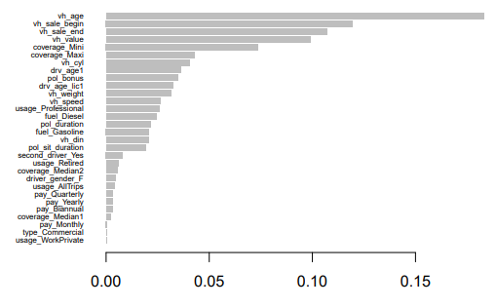
Variable Triaging
Variable Importance Plots
Provide a measure of which variables are relatively more important than others
High importance variables should be evaluated as they will have the greatest impact on consumers
Low importance variables should be evaluated for whether there is a good reason to include them
Similar to questioning variables with high p-values in a GLM

Slide 16
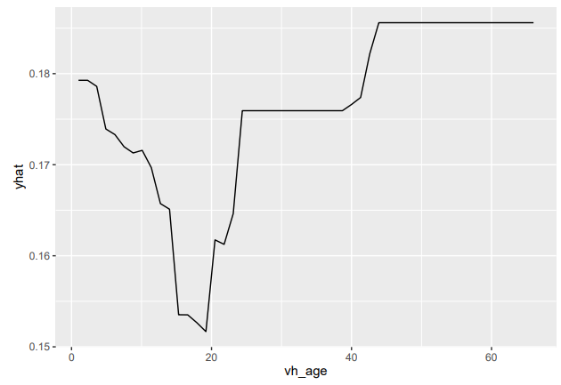
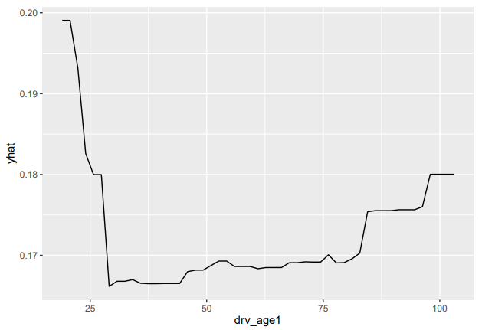
Interpretability Plots
Partial Dependence Plots
Computes the marginal effect of a given feature on the prediction
Fixes the value of the predictor variable of interest, calculating the model prediction for each observation using the fixed value
Repeat for all values of the predictor variable

Slide 17
Interpretability Plots
Accumulated Local Effects
Better option in the case of correlated features
Calculates and accumulates incremental changes in the feature effects
Shows the expected and centered effects of a feature, like a coefficient in a GLM

Slide 18
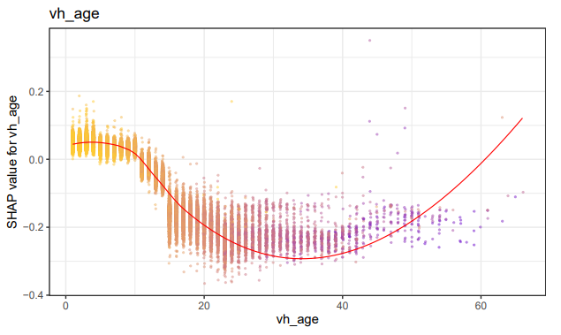
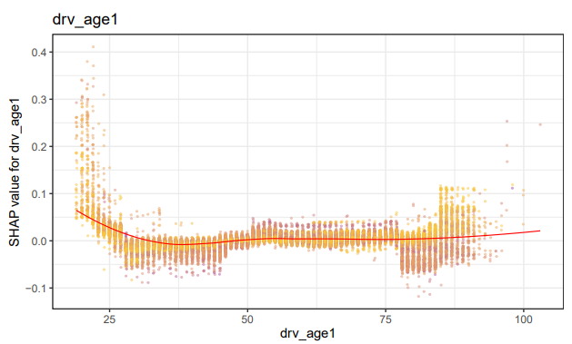
Interpretability Plots
Shapely Additive Explanations
How much that feature moves the prediction away from the overall average prediction.
>0, feature increases predicted value higher than average value
<0, feature decreases predicted value lower than average value

Slide 19
Challenges – Prone to Overfit
Review general narrative on setting of hyperparameters
Hyperparameter Consideration
Number of trees should be large enough, but no larger
Look at plot to minimize OOB/Test Error or Deviance
Learning Rate
Greater than 0, commonly < 0.2
Tree Complexity
Minimum node size should be set high enough for reasonable credibility
Rule of Thumb: Max depth of > 8 may be too high
Other hyperparameters should be disclosed and briefly commented on
Bootstrap sample size (% of rows)
Random Variables tried for each split (# of columns)
Criteria to split should match the model purpose (classification, regression)
Review lift charts on test/holdout data

Slide 20
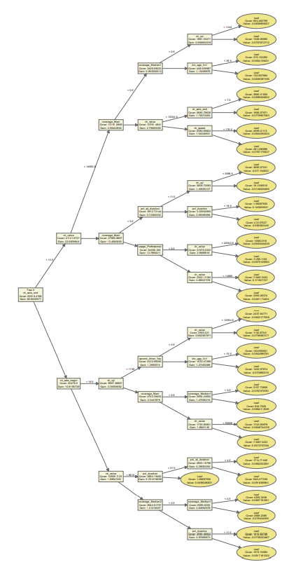
Challenges - Auditability
Comprehensive Documentation
Allows for third party audit
Makes reproducing predictions from data to decision possible
Ideally would not require understanding complex code or specific software
Document entire tree ensemble
Print tree logic for each tree OR
Plot all trees OR
Provide a table with prediction for all possible values

Slide 21
Challenges - Auditability
Sample Prediction Examples
Exhibits could be made for spot-checking against tree documentation
Input Predictors
Individual Tree Predictions
Overall Model Prediction
However, auditing every prediction for a book of business would still be extremely difficult

Slide 22
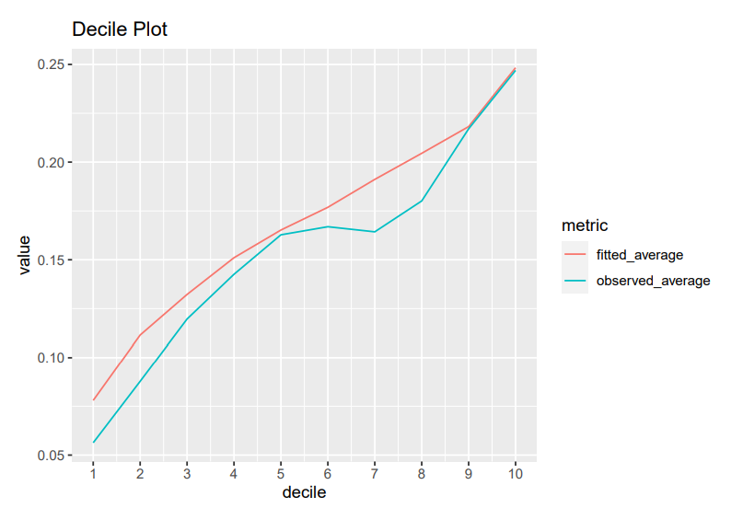
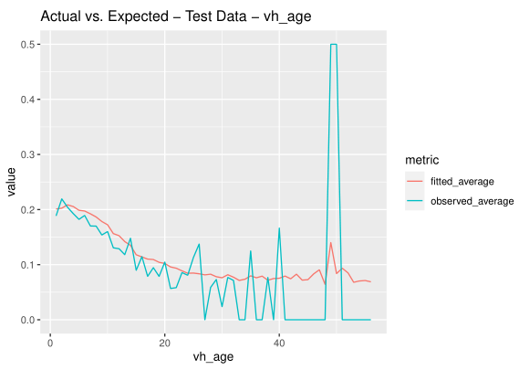
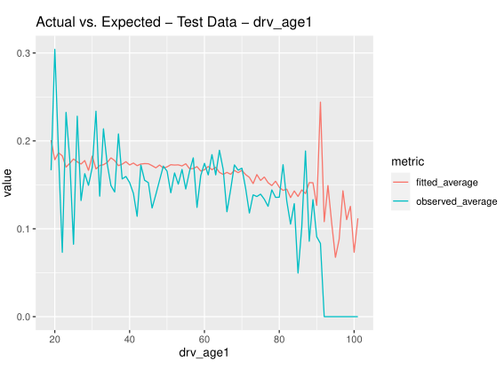
Review Other Useful Exhibits
Quantile Plots on Holdout Data
Compares fitted average to observed average by Quantile
Actual vs. Expected plots on Holdout Data
Separate plot by variable
Demonstrates fit across variable levels

Slide 23
Reading References
Basic Decision Tree Terminology
https://medium.datadriveninvestor.com/the-basics-of-decision-trees-e5837cc2aba7
Theoretical Introduction to Random Forest and Boosted Trees
Introduction to Statistical Learning (Chapter 8 – 8.2.3)
https://web.stanford.edu/~hastie/ISLRv2_website.pdf
Interpretable Machine Learning (Variable Importance and Interpretability Plots)
https://us.milliman.com/-/media/milliman/pdfs/2021-articles/4-2-21-interpretable-machine-learning.ashx

Slide 24
Other References
YouTube Videos:
Actuarial Virtual Data Science Seminar: Risk Pricing with XGBoost
https://www.youtube.com/watch?v=sOyMLB1SsFk
CASTF Book Club Call: Tree Based Models
https://www.youtube.com/watch?v=6UCbpAt4r9M
CASTF Book Club Call: Interpretable Machine Learning
https://www.youtube.com/watch?v=-yMdTAIkewk
Sample Model R Markdown
Illustration purposes only, primarily created to demonstrate sample plot types
https://github.com/skloese/Insurance-Pricing-XGBoost-Example/tree/main
E-mail skloese@naic.org if you’d like to see the plots in PDF

